Slide 1


[Part 2]
FUNCTIONS
Semester (1) : 2015/2016

Slide 2
FUNCTION
Let X and Y are nonempty sets.
A function (f) from X to Y is a relation from X to Y having a properties:
  The domain of f is X
  If (x,y), (x,y’) ∈ f, then y =y’

Slide 3
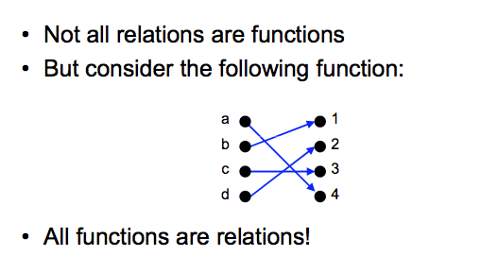
Relations vs Functions

Slide 4
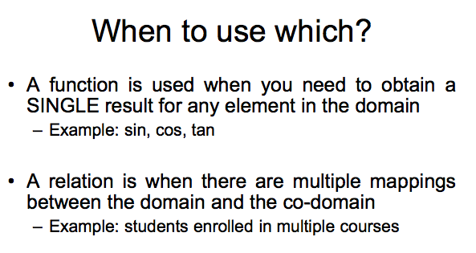
Relations vs Functions

Slide 5
Domain, Co-domain, Range
A function from X to Y is denoted, f : X → Y
The domain of f is the set X.
The set Y is called the co-domain or target of f.
The set { y | (x,y) ∈ f } is called the range.

Slide 6
Example
Given the relation, f = { (1,a), (2,b), (3,a) } from X = { 1, 2, 3 } to Y= { a, b, c } is a function from X to Y. State the domain and range.
Solution:
The domain of f is X
The range of f is {a, b}

Slide 7
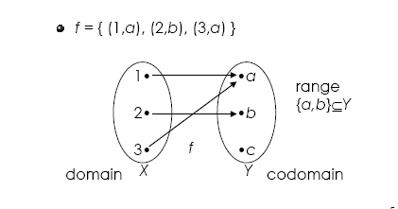
Example (cont.)

Slide 8
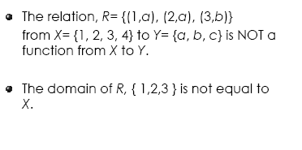
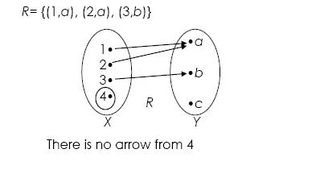
Example

Slide 9
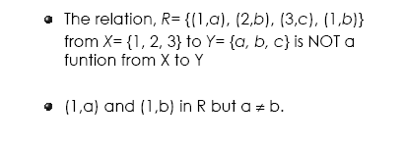
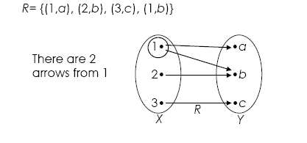
Example

Slide 10
Notation of function: f(x)
For the function, f = {(1,a), (2,b), (3,a)}
We may write:
  f (1)=a, f (2)=b, f (3)=a
Notation f (x) is used to define a function.

Slide 11
Example
Defined: f (x) = x²
f (2) = 4, f (-3.5) =12.25, f (0) = 0
f = {(x, x² )| x is a real number}

Slide 12
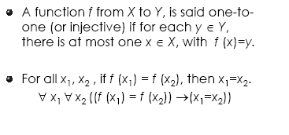
One-to-One Function

Slide 13
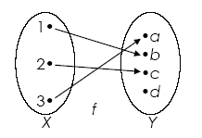
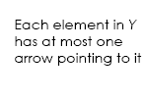
Example
The function, f = { (1,b), (3,a), (2,c) } from X = { 1, 2, 3 } to Y = { a, b, c, d } is one-to-one.

Slide 14
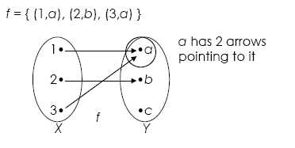
Example (cont.)
The function, f = { (1,a), (2,b), (3,a) } from X = { 1, 2, 3 } to Y = { a, b, c} is NOT one-to-one.
f (1)= a = f (3)

Slide 15
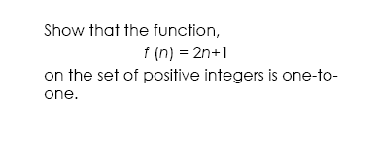
Example

Slide 16
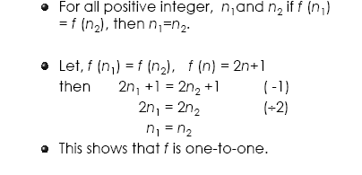
Solution

Slide 17
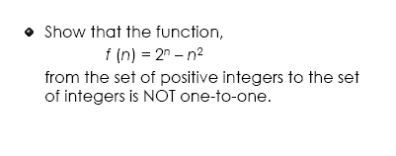
Example

Slide 18
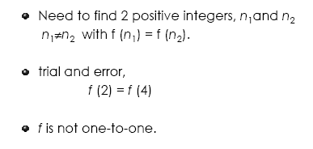
Solution

Slide 19
Onto Function
If f is a function from X to Y and the range of f is Y, f is said to be onto Y (or an onto function or a surjective function)
For every y ∈ Y, there exists at least one x ∈ X such that f (x) = y
∀ y ∈ Y ∃ x ∈ X ( f (x) = y )

Slide 20
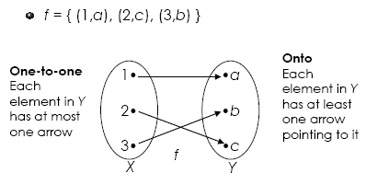
Example
The function, f = { (1,a), (2,c), (3,b) } from X = { 1, 2, 3 } to Y = { a, b, c } is one-to-one and onto Y.

Slide 21
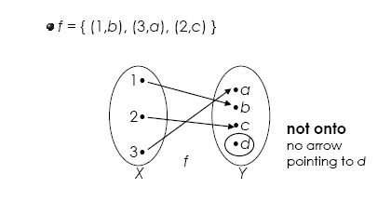
Example
The function, f = { (1,b), (3,a), (2,c) } is not onto Y = {a, b, c, d}

Slide 22
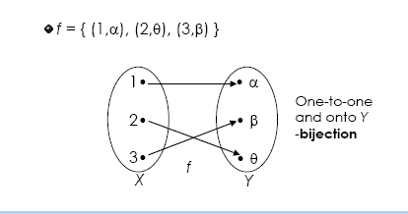
Bijection Function
A function, f is called one-to-one correspondence (or bijective/bijection) if f is both one-to-one and onto.
Example:

Slide 23
Exercise
Determine which of the relations f are functions from the set X to
the set Y. In case any of these relations are functions, determine if
they are one-to-one, onto Y, and/or bijection.
X = { -2, -1, 0, 1, 2 } , Y = { -3, 4, 5 } and
f = { (-2,-3), (-1,-3), (0,4), (1,5), (2,-3) }
b) X = { -2, -1, 0, 1, 2 } , Y = { -3, 4, 5 } and
f = { (-2,-3), (1,4), (2,5)}
c) X = Y= { -3, -1, 0, 2 } and
f = { (-3,-1), (-3,0), (-1,2), (0,2), (2,-1) }

Slide 24
Inverse Function
Let f: X→Y be a function.
The inverse relation f ⁻¹ ⊆ Y×X is a function from Y to X, if and only if f is both one-to-one and onto Y.

Slide 25
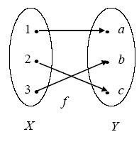
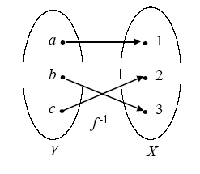
Example
f = {(1,a),(2,c),(3,b)}
f ⁻¹= {(a,1),(c,2),(b,3)}

Slide 26
Example
The function, f (x) = 9x + 5 for all x ∈ R (R is the set of real numbers).
This function is both one-to-one and onto.
Hence, f ^{–1} exists.
Prove:
  Let (y, x) ∈ f ⁻¹, f ⁻¹(y) = x
  (x,y) ∈ f, y = 9x + 5
  x = (y-5)/9
  f ⁻¹(y) = (y-5)/9

Slide 27
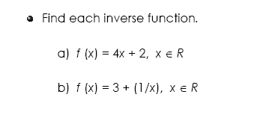
Exercise

Slide 28
Composition
Suppose that g is a function from X to Y and f is a function from Y to Z.
The composition of f with g,
f ο g
is a function
(f ο g)(x) = f (g(x))
from X to Z.

Slide 29
Example
Given, g = { (1,a), (2,a), (3,c) }
  a function from X = {1, 2, 3} to Y = {a, b, c}
  and,
  f = { (a,y), (b,x), (c,z) }
  a function from Y to Z = { x, y, z }.
The composition function from X to Z is the function
  f ο g = { (1,y), (2,y), (3,z) }

Slide 30
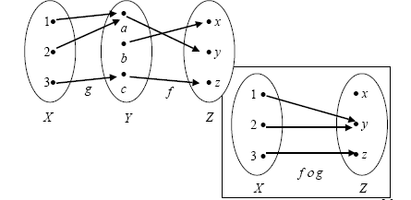
Example (cont.)

Slide 31
Example
f (x) = log₃ x and g (x) = x⁴
f (g (x)) = log₃ ( x⁴ )
g (f (x)) = (log₃ x) ⁴
Note: f ο g ≠ g ο f

Slide 32
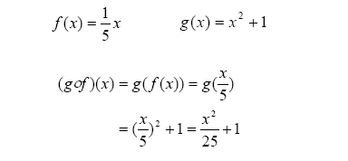
Example

Slide 33
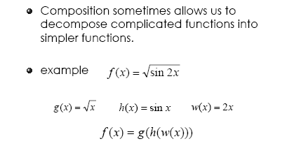
Example

Slide 34
Exercise
Let f and g be functions from the positive integers to the positive integers defined by the equations, f (n) = n² , g(n) = 2^{n}
Find the compositions
  a) f ο f
  b) g ο g
  c) f ο g
  d) g ο f

Slide 35
Recursive Algorithms
A recursive procedure is a procedure that invokes itself.
A recursive algorithm is an algorithm that contains a recursive procedure.
Recursion is a powerful, elegant and natural way to solve a large class of problems.

Slide 36
Example
Factorial problem
If n ≥1,
  n! = n (n -1) => 2x1
  and 0! = 1
Notice that, if n ≥ 2, n factorial can be
  written as,
  n! = n(n -1)(n -2) => 2x1x0
  = n(n-1)!

Slide 37
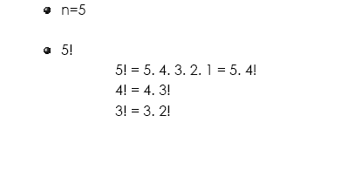
Example

Slide 38
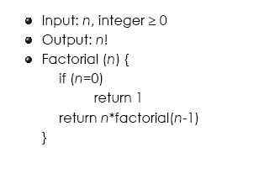
Recursive Algorithm for Factorial

Slide 39
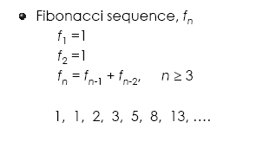
Example
for

Slide 40
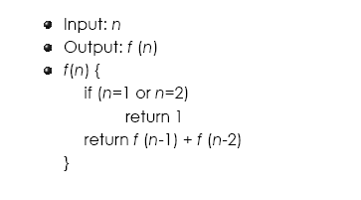
Recursive algorithm for Fibonacci Sequence :

Slide 41
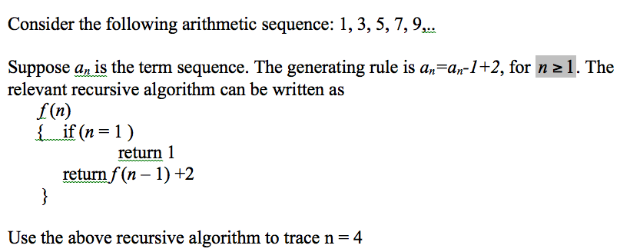
Example

Slide 42
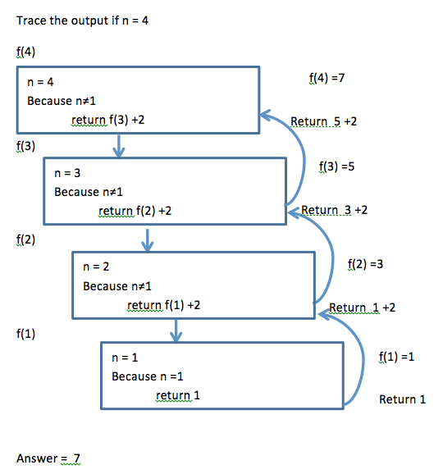
Example- Solution

